Slide 1
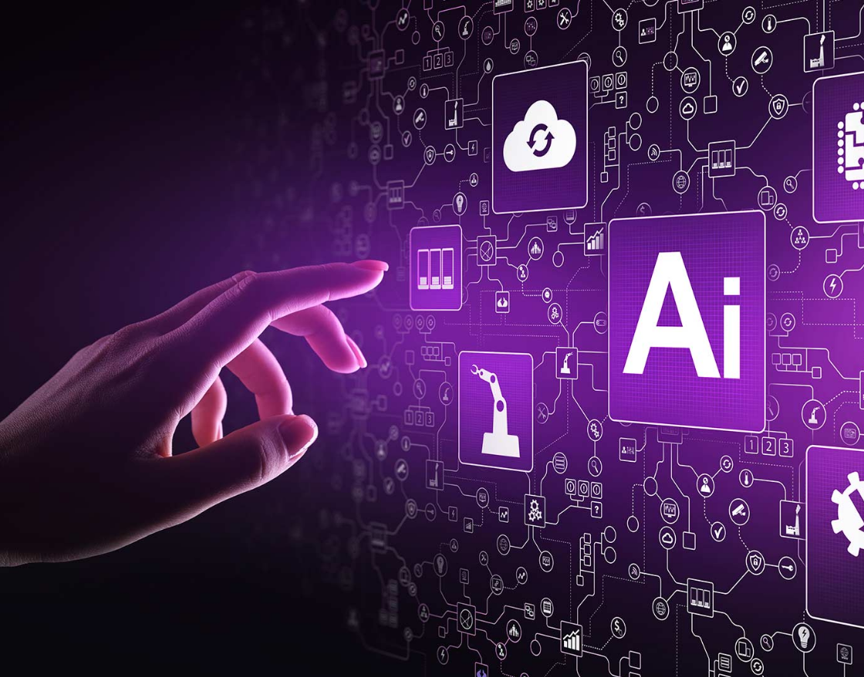
Artificial Intelligence
Nimbus 2k22
By Sandesh Gajendra Pol

Slide 2
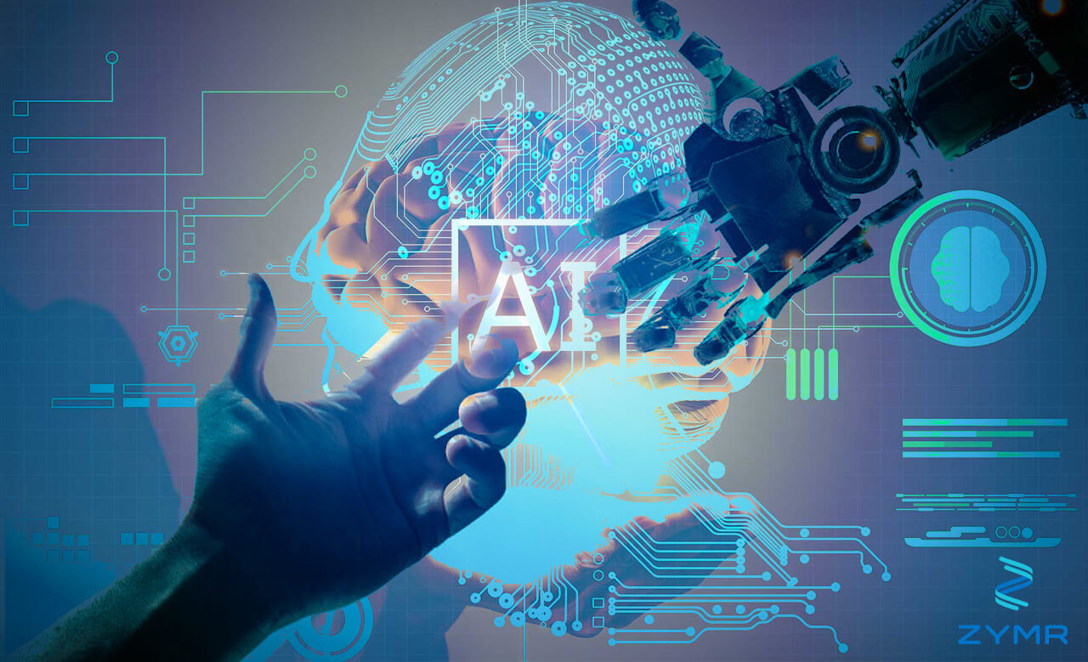
Point to be discussed
What is Artificial Intelligence
Working
Application and Case study
on AI & ML
Conclusion
Major Artificial Intelligence techniques

Slide 3
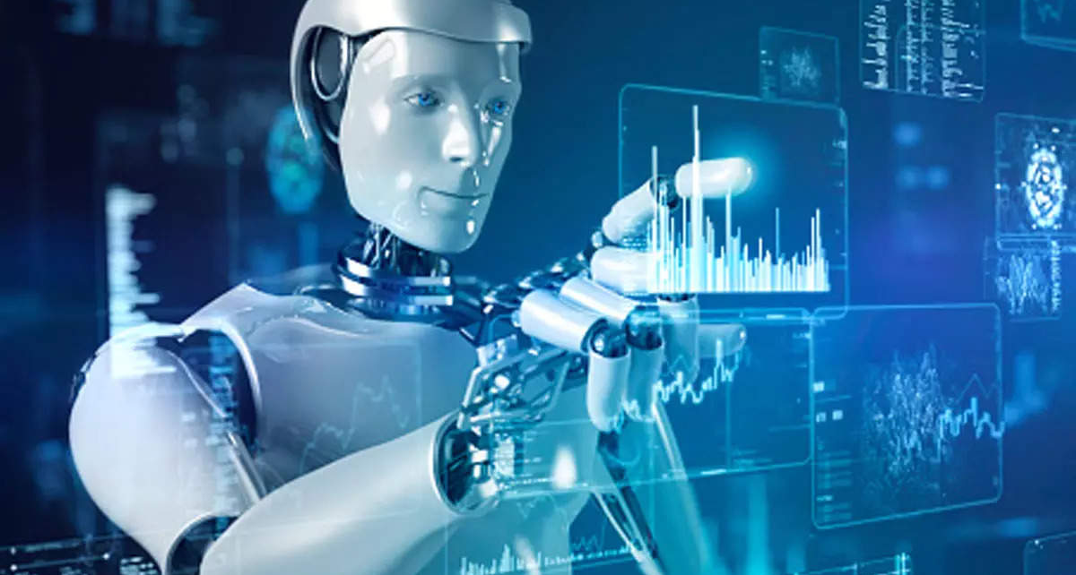
What is Artificial Intelligence
AI is the ability of the machines or computer program To carry out tasks that requires human beings to use their intelligence
Artificial intelligence is the ability of a computer program or a machine to think and learn.
AI research really started with a conference at Dartmouth College in 1956.
The teams Machine Learning and Deep Learning is sub set of Artificial Intelligence

Slide 4
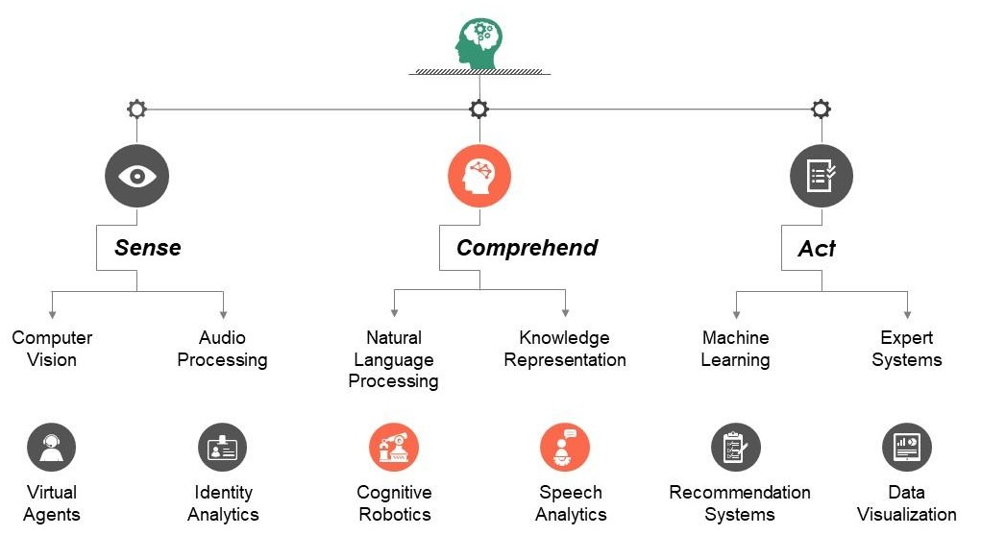
Classification of artificial intelligence

Slide 5
Major Artificial Intelligence techniques
Rules and logic base approach
Machine learning based approach
Hybrid system

Slide 6
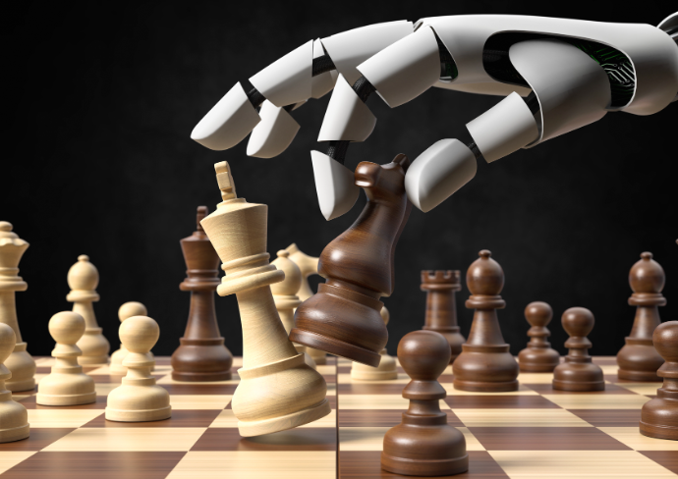
Rules and logic base approach
In computer science, a rule-based system is used to store and manipulate knowledge to interpret information in a useful way. It is often used in artificial intelligence applications and research
Applications
an expert system might help a doctor choose the correct diagnosis based on a cluster of symptoms,
2. select tactical moves to play a game.

Slide 7

Machine learning based approach
A technique that allows computer to learn
It make computer able to predict
Basic premise is built algorithms that they can receive input data and use statistical analysis to predict an output values
Applications
Stock market Prediction using machine learning
Image classification
Weather Forecasting
AI Games

Slide 8
Working of Artificial Intelligence
Data Input
-Text ,Image, Context, Speech, etc
Data Processing
- Interpret , Predict ,Art
Outcome
- Success , Failure ,
Assessment
-Analysis , Discovery , Feedback
- Algorithm & rules , Outcomes

Slide 9
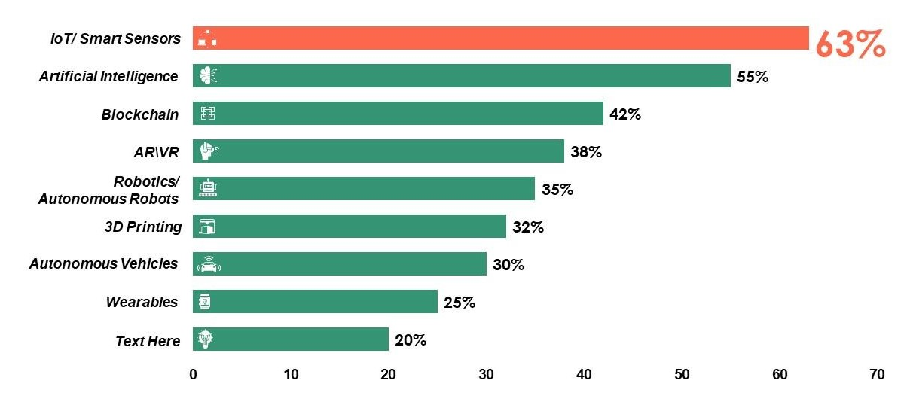
Survey on Adoption of Emerging Technologies

Slide 10
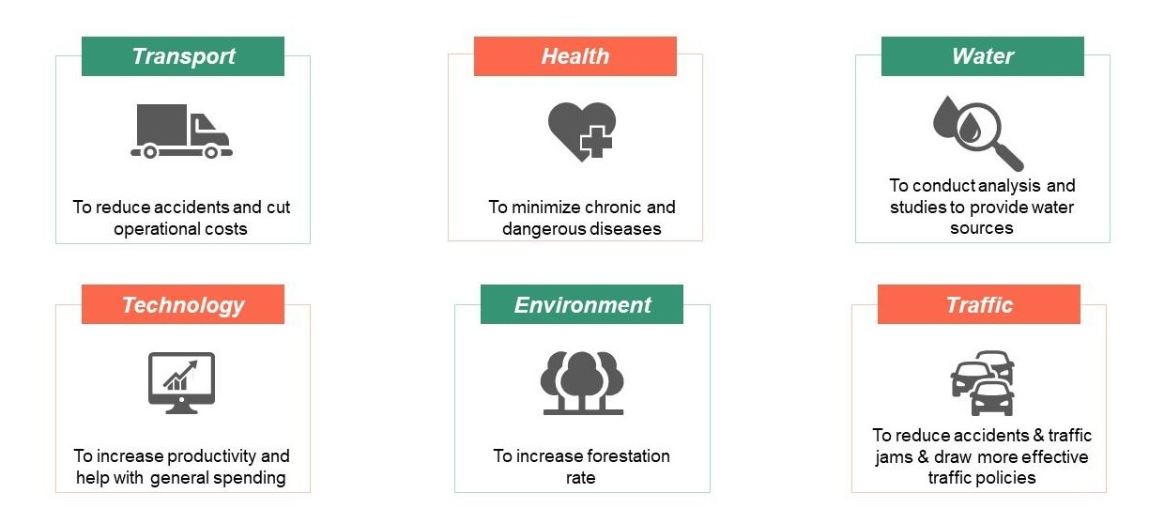
Application of Artificial

Slide 11

Case study on AL
Google search engines and shopping ads

Slide 12
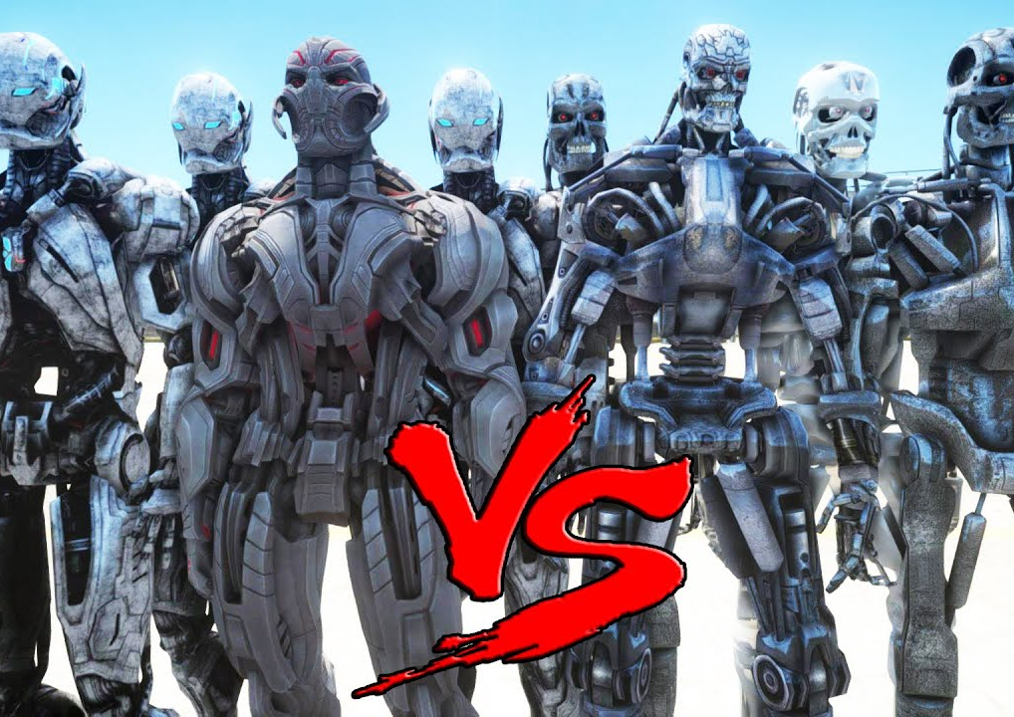
Scientist Prediction About AI
A research paper warns that artificial intelligence is “likely” to kill the human race. Google and Oxford Scientists claim that AI will fight with humans for scarce resources on earth. Researchers say it’s almost inevitable that smart machines will win against humans.

Slide 13
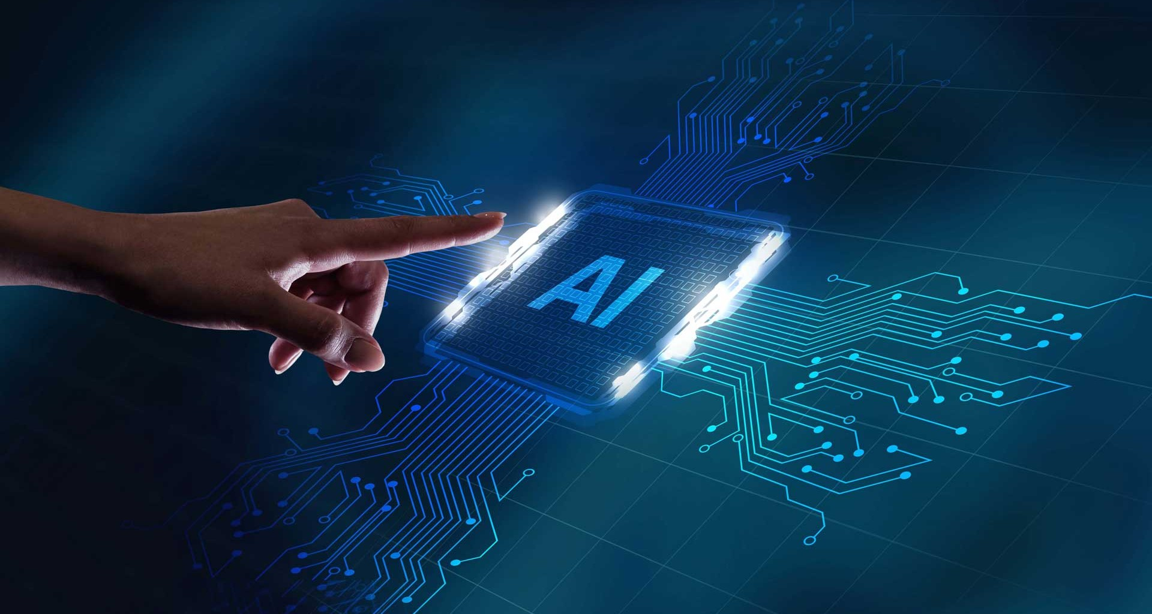
Conclusion
AI is most dangerous Thing on earth
Artificial intelligence weapons
There are many incidence that scientist reported that AI can destroy humanity
In AI and field there is very good scope for career.
There are large scope in this field

Slide 14
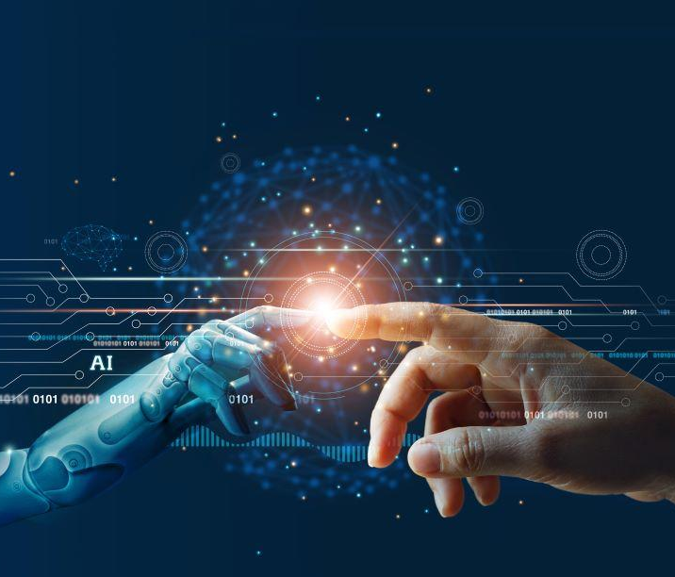
THANK YOU!
Sandesh Gajendra Pol
Phone:
9067248106
Email:
sandeshpol268@gmail.com

